Slide 1
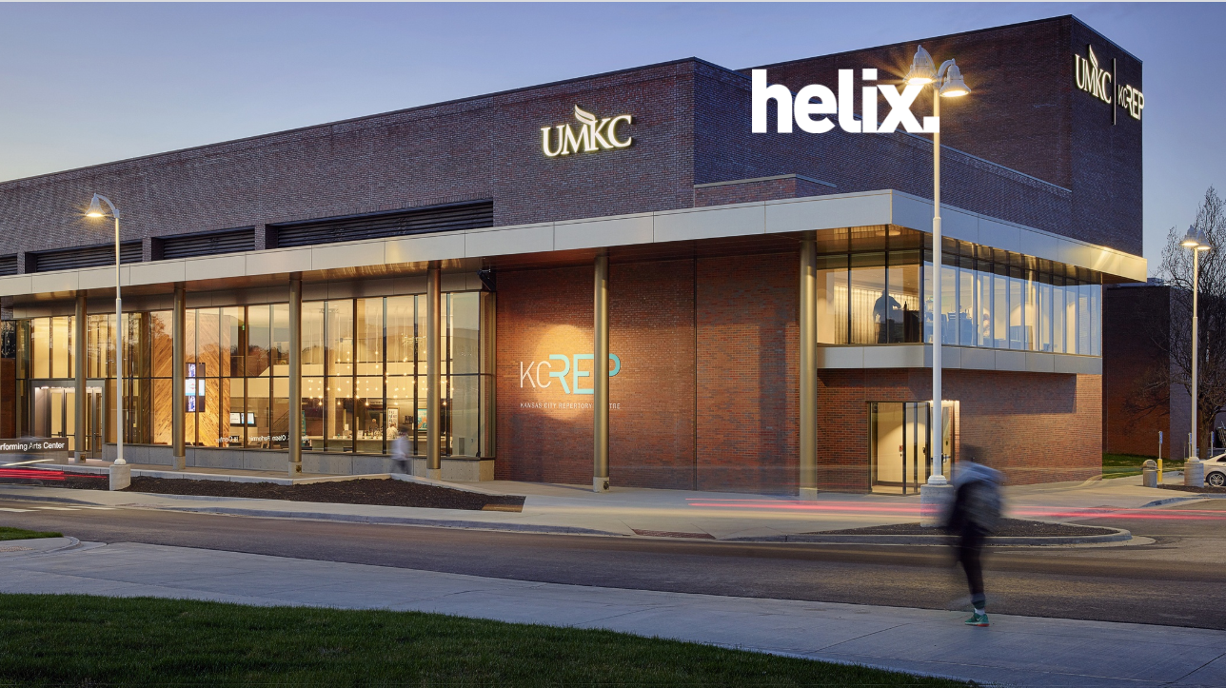

UMKC RIDe
**Computer Science 5525 0001 Cloud Computing Final Presentation**
Team: 12
Avinash Ganguri (16293133)
Divya Reddy Bandari(16281700)
Bhashitha Siddareddy(16291369)

Slide 2
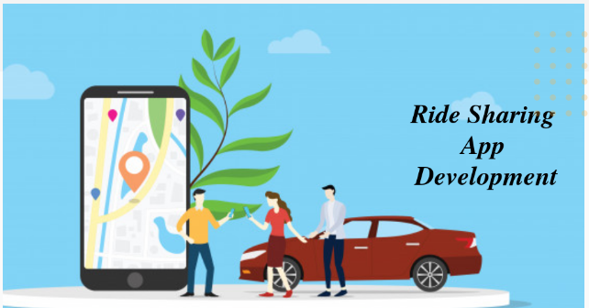


Objective
Build a Hybrid Application for UMKC to provide convenient transportation facilities to the students and staff. The App allows users to request a pickup. The request is sent with the location, and the nearest driver will be notified about the pickup location. Once the driver accepts the pickup, it automatically routes the driver with least possible distance and
Estimated Time Arrival.
UMKC

Slide 3

Motivation
There are users who prefer pool share service or a shuttle service provided by the organization rather than a cab.
This is the rise of UMKC RIDE share service idea.
By this you can also get connected with new people in UMKC/Organization and can enhance your network.

Slide 4
Accomplishments
Created an IONIC Application for UMKC Ride share service where a Service Requester or Service provider sign in and can start the service.
Created an Angular Application as admin control for extending the UMKC Ride share service to different organizations.
Hosted the Web Application through Microsoft Azure Services.

Slide 5
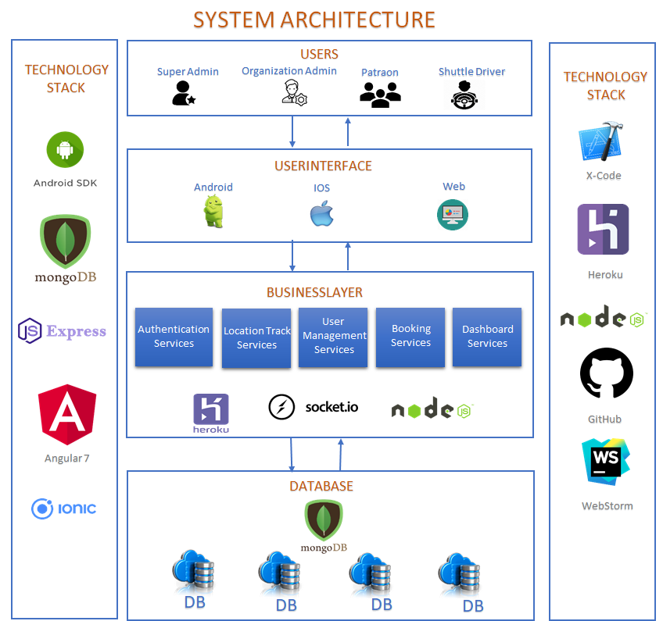
System Architecture

Slide 6
Implementation Environments
IONIC Framework
Angular Framework
Webstorm
MongoDB
Microsoft Azure Cosmos DB
Karma Tool

Slide 7
UMKC RIDE Workflow
Ride Requestor
Selecting source & destination
Calculating the ETA based on the source and destination and getting displaying ETA
Showing the nearby ride providers, ETA & can booking the ride
Registration
Login
Book a Ride
Ride Provider
Notified Booking Alert
Accepting & Starting Ride
Directions for safe Journey

Slide 8
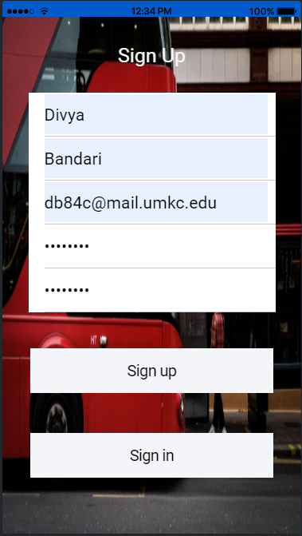
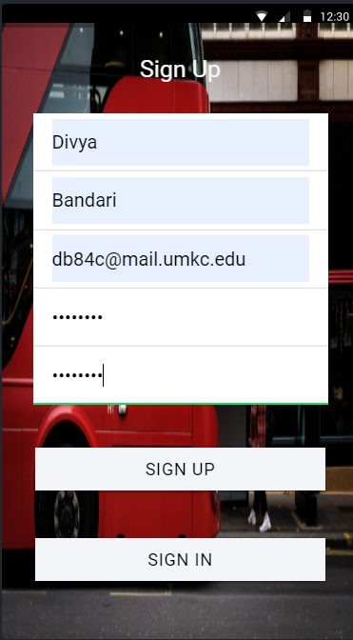
IOS
Android
Sign Up Page
This is the Sign-Up Page for UMKC RIDE here the user has to Enter their first name, last name , email id , password, confirm password. And then they can sign up.

Slide 9
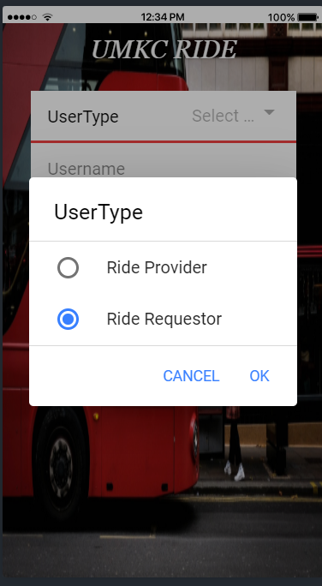
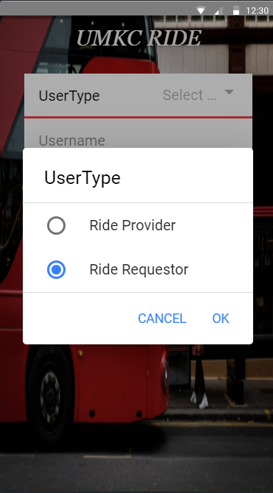
IOS
Android
Sign In Page
Once the user provides all the details and sign up they get navigated to the Sign In page.
Here they must select the
User type :
Ride Provider: The one who offers the ride
Ride Requestor: The one who is requesting the ride.

Slide 10
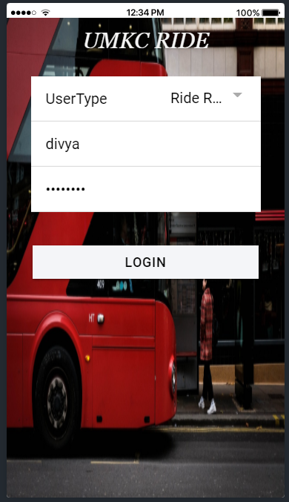
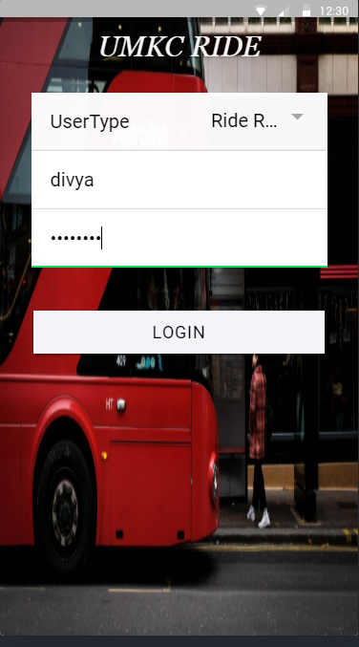
IOS
Android
Sign In Page
Once done with selecting the user type they have to enter their credentials i.e. username, password and click on login button.

Slide 11
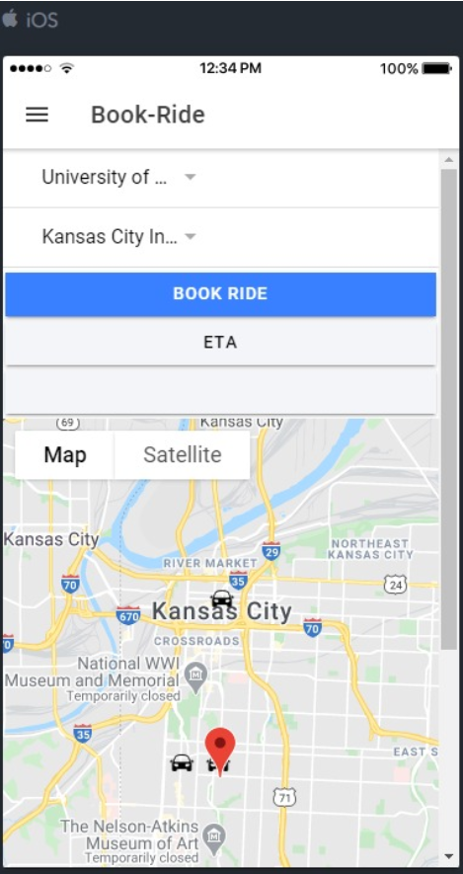
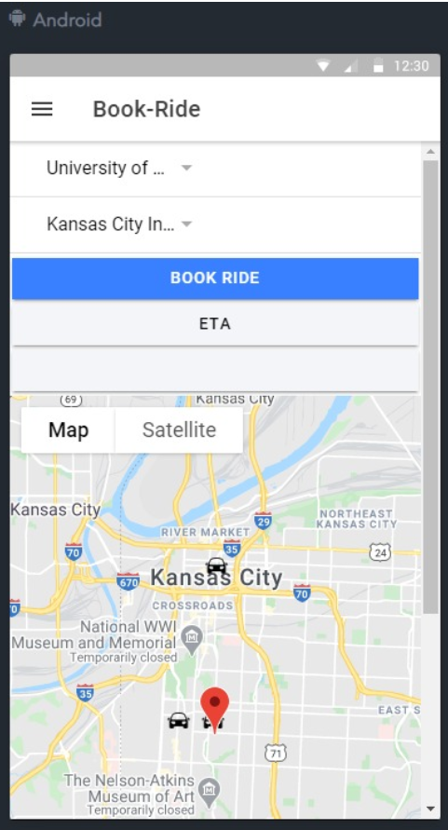
IOS
Android
Book-a-Ride
When the User could successfully login into UMKC as the ride requestor, the user has to select the source, destination and click on the Book Ride

Slide 12
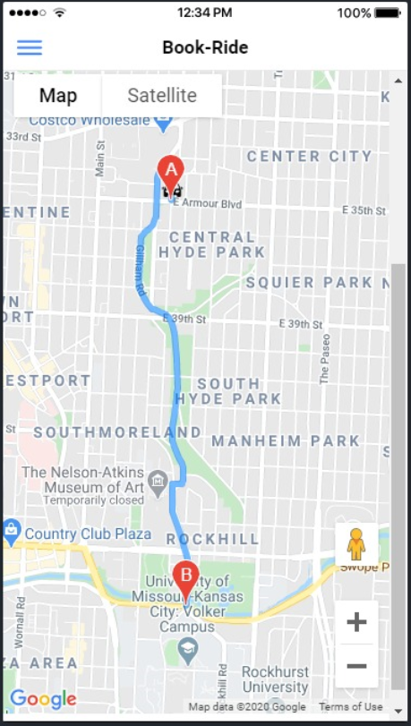
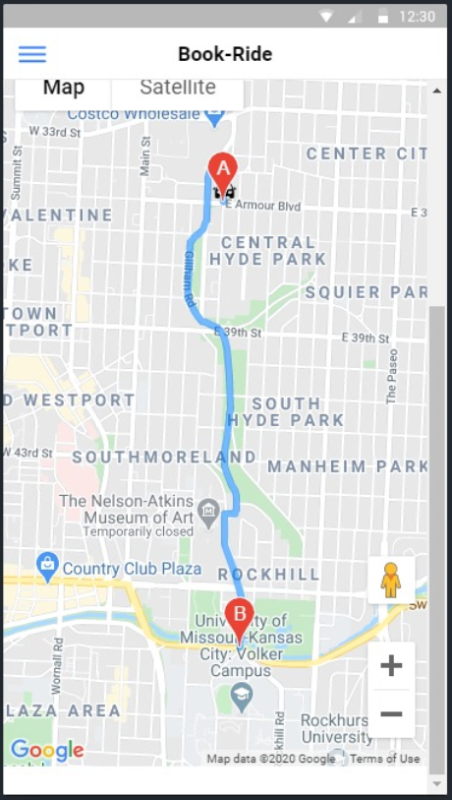
IOS
Android
Book-a-Ride
When the User click on Book Ride, the user could able to see the ride provider location and directions to their destination.

Slide 13
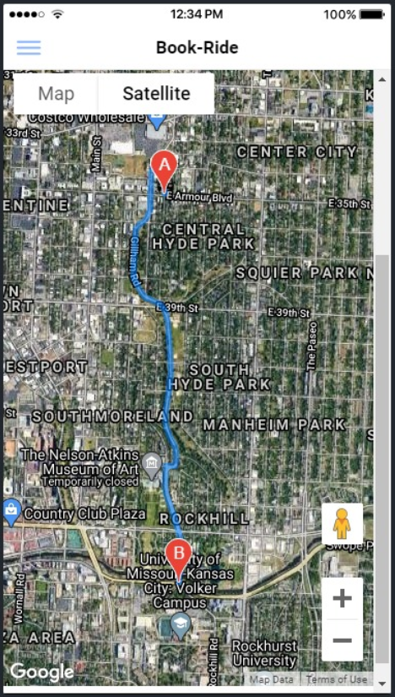
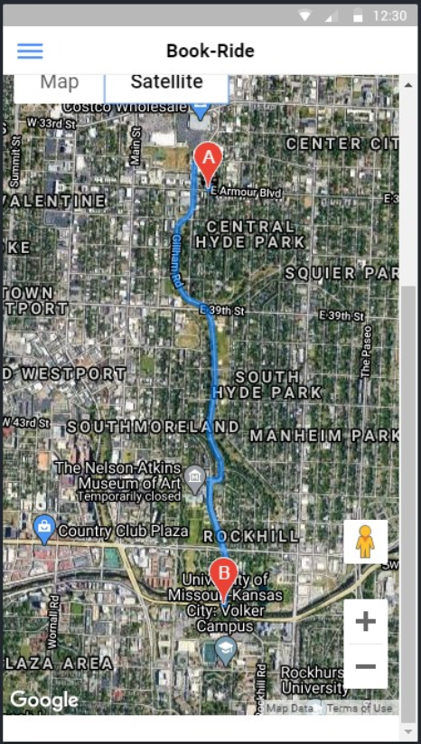
IOS
Android
Book-a-Ride
When the User click on Book Ride, the user could able to see the ride provider location and directions to their destination in the map and satellite version. The satellite version can be seen here.

Slide 14
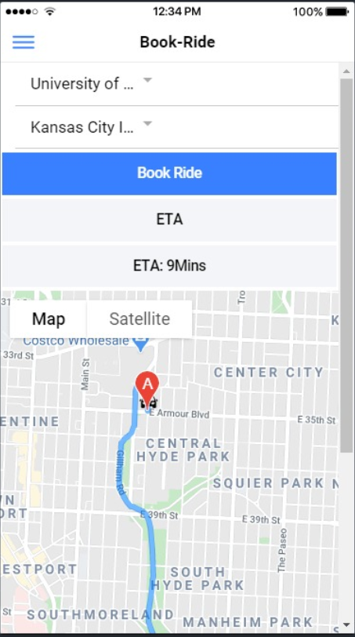
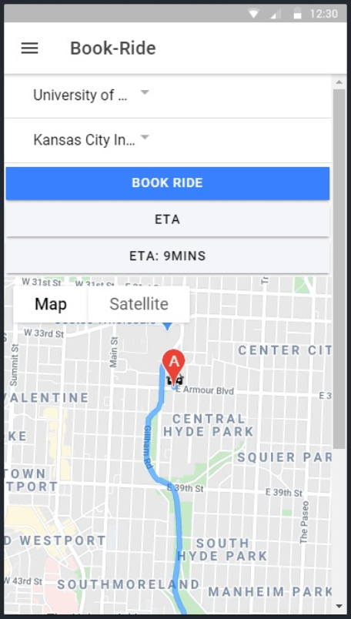
IOS
Android
ETA Calculation
After booking the ride when the user clicks on the ETA, the Estimated time of arrival will be displayed.

Slide 15
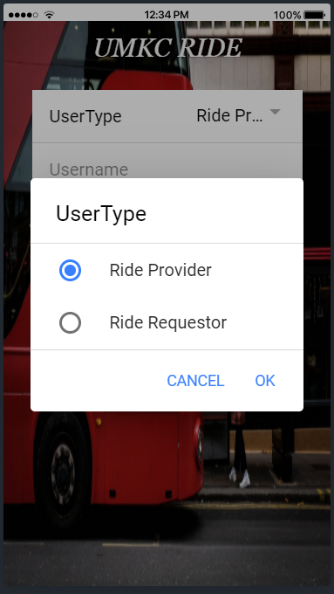
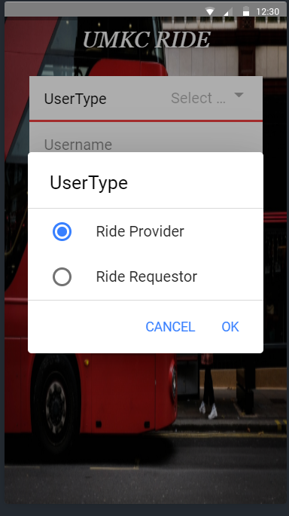
IOS
Android
Ride Provider Sign In
By selecting the user type as Ride provider the user could able to provide the ride if ride requestor has booked a ride.

Slide 16
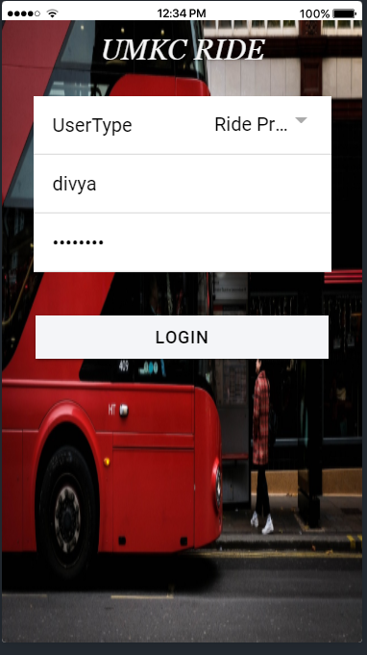
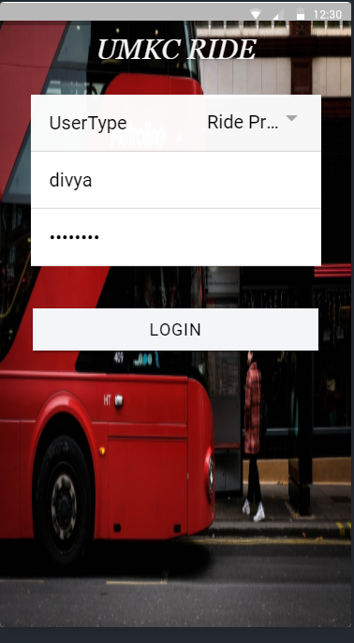
IOS
Android
Ride Provider Sign In
Once done with selecting the user type as ride provider they have to enter their credentials i.e. username, password and click on login button.

Slide 17
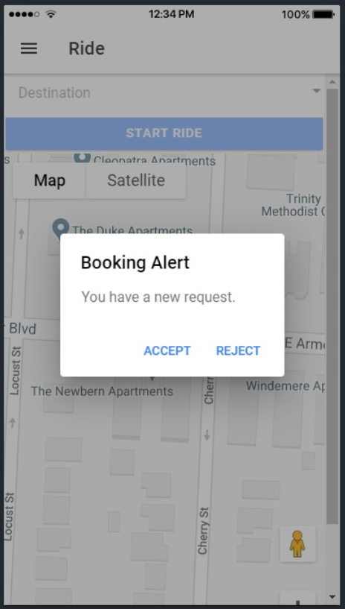
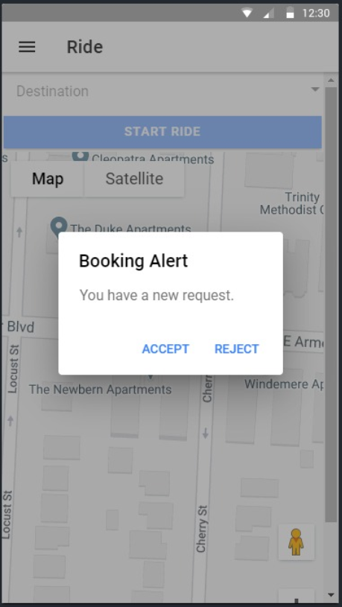
IOS
Android
Ride Page
After logining into as the ride provider if they are any ride request, the user will get the Booking Alert. Here they can Accept or Reject the ride request.

Slide 18
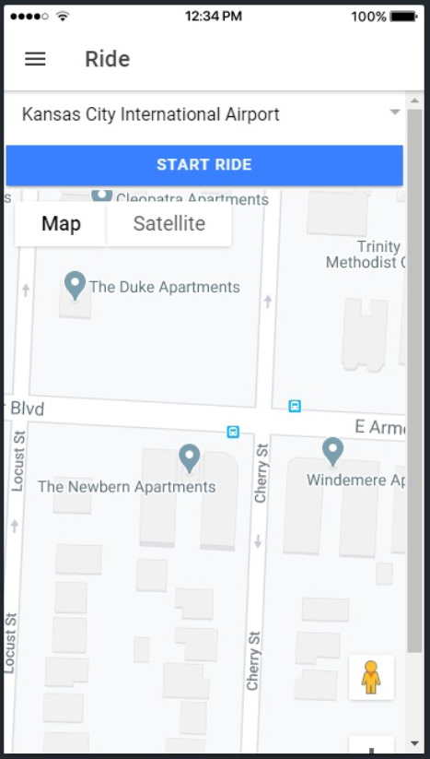
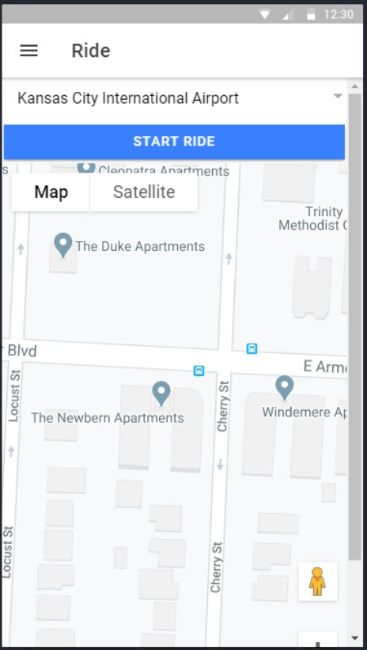
IOS
Android
Ride Page
When the ride provider has accepted the ride, the user will navigate to this page and now they can start the ride.

Slide 19
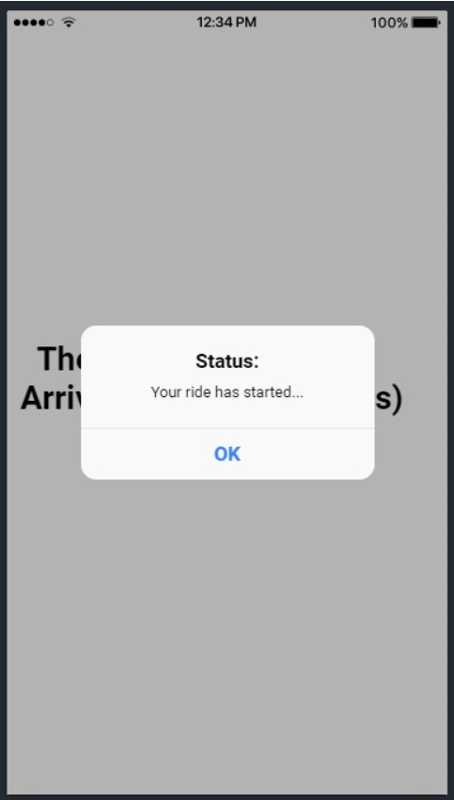
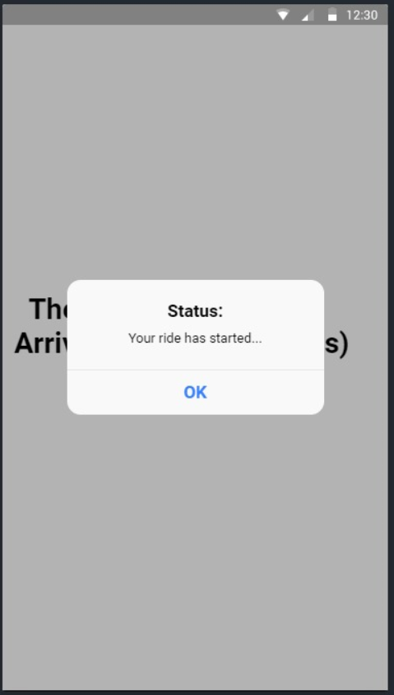
IOS
Android
Ride Page
Once the ride provider has started the ride and he will get the status stating that your ride has started.

Slide 20
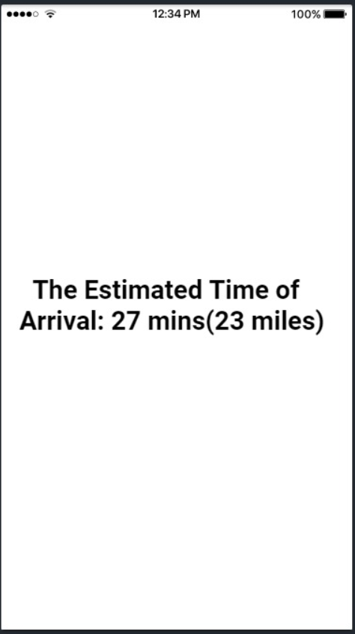
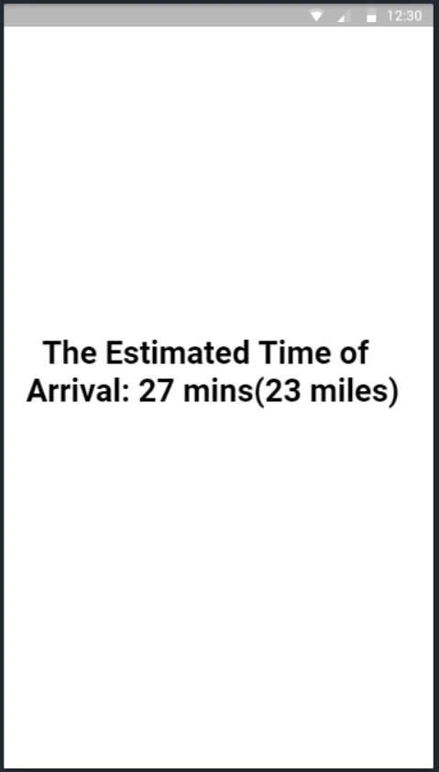
IOS
Android
Ride Page
Once the ride provider has started the ride he will get the time to reach the destination and number of miles to destination.

Slide 21
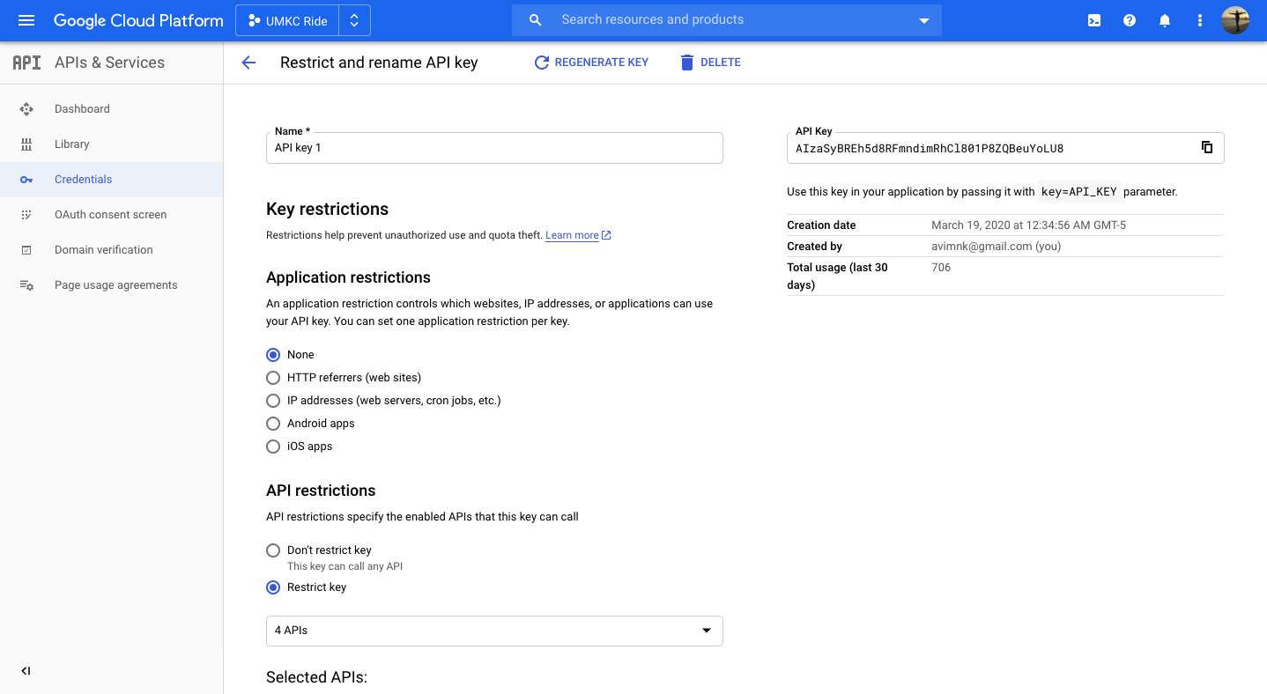
Google Maps API’s from GCP

Slide 22
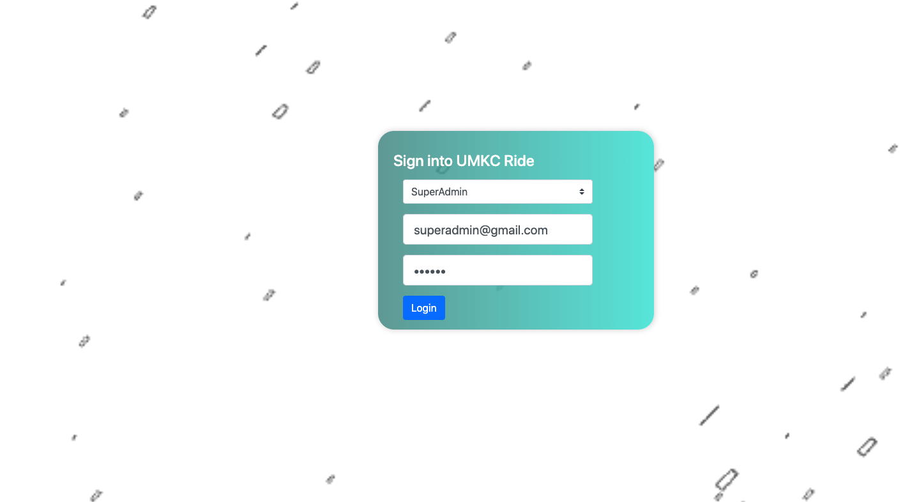
Web Application for Admin Management

Slide 23
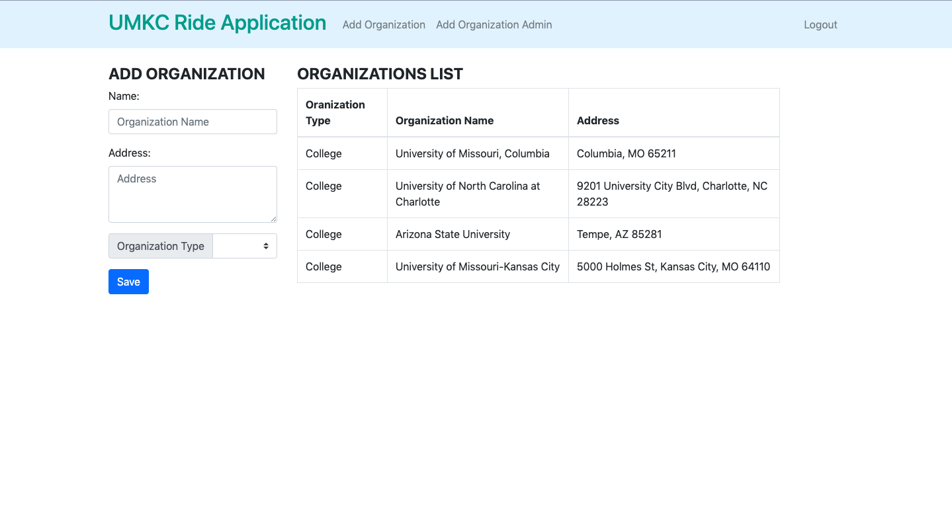

Slide 24
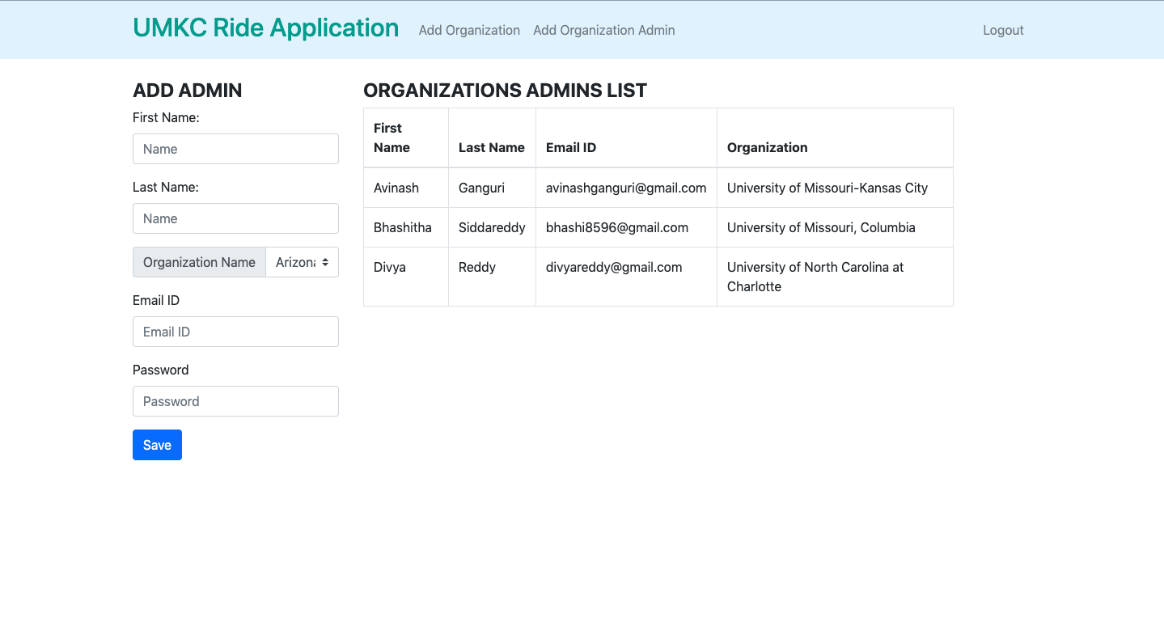

Slide 25


Slide 26
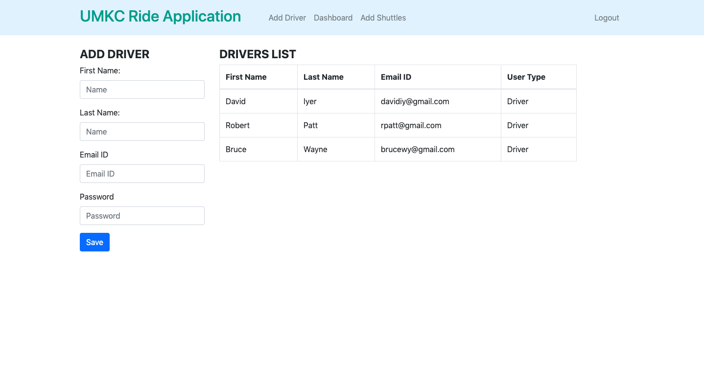

Slide 27
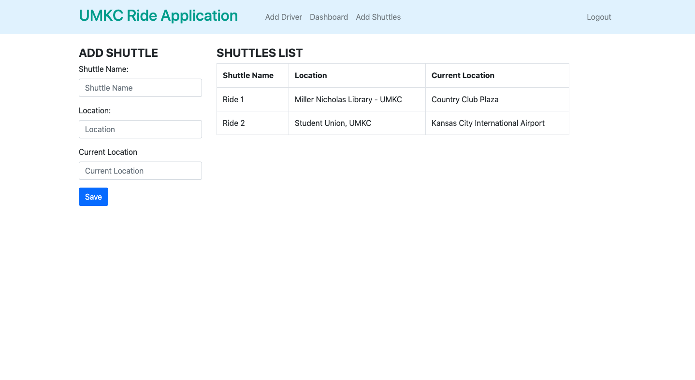

Slide 28
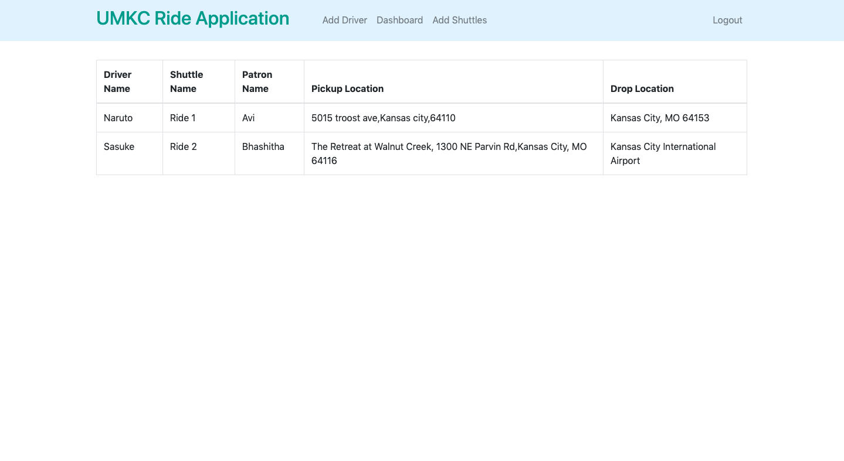

Slide 29
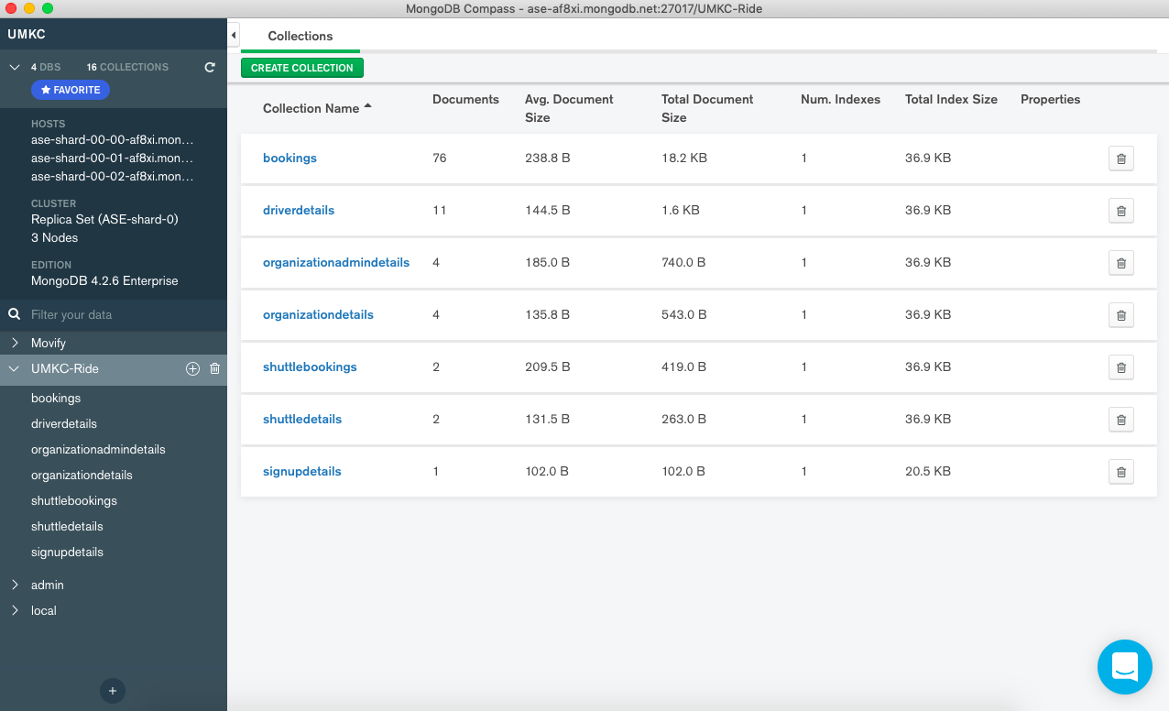
MongoDB Database Collections

Slide 30
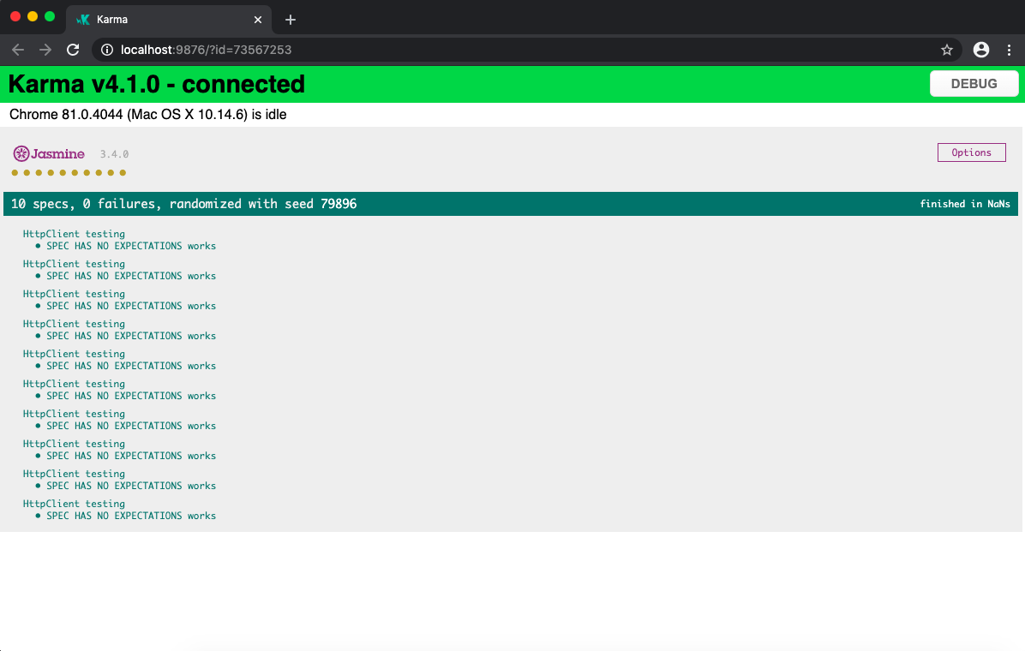
Testing
Unit Testing and Integration Testing are done through Jasmine Framework and Karma

Slide 31
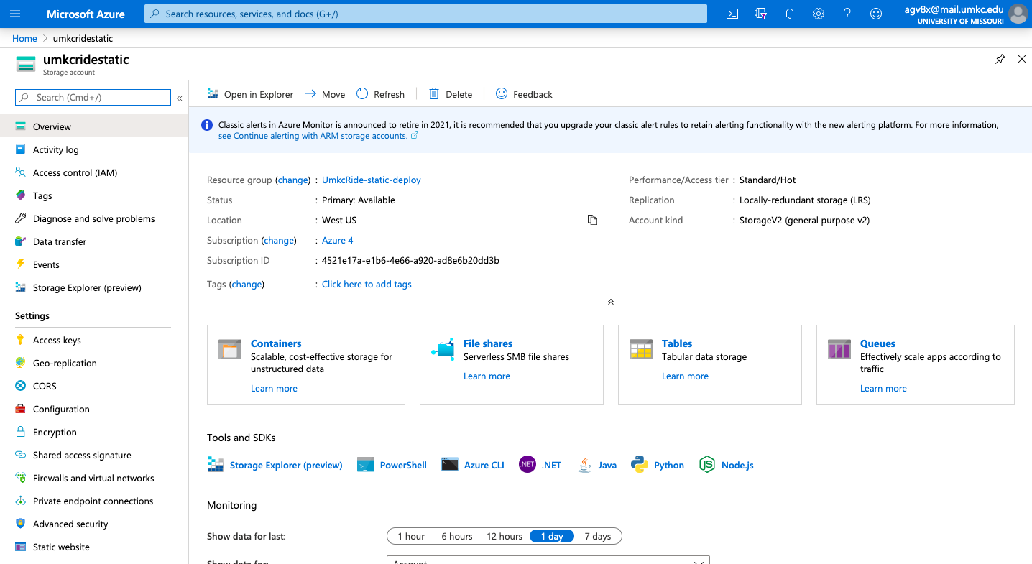
Deployment using Microsoft Azure Services

Slide 32
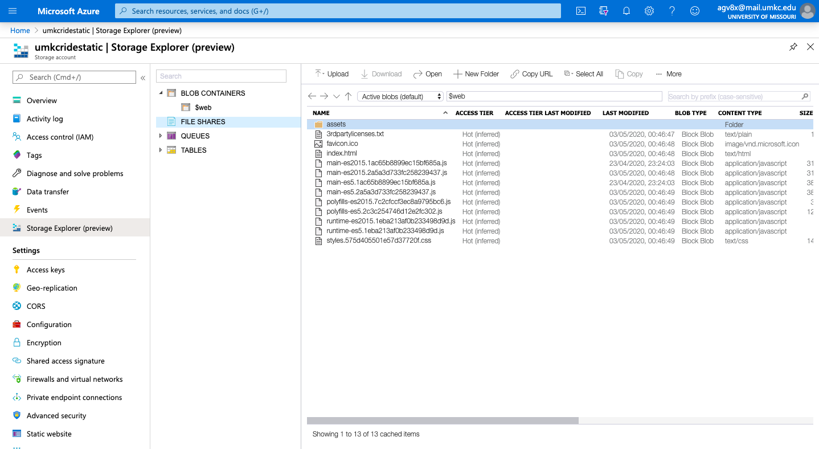
Dist folder uploaded to BLOB Storage

Slide 33
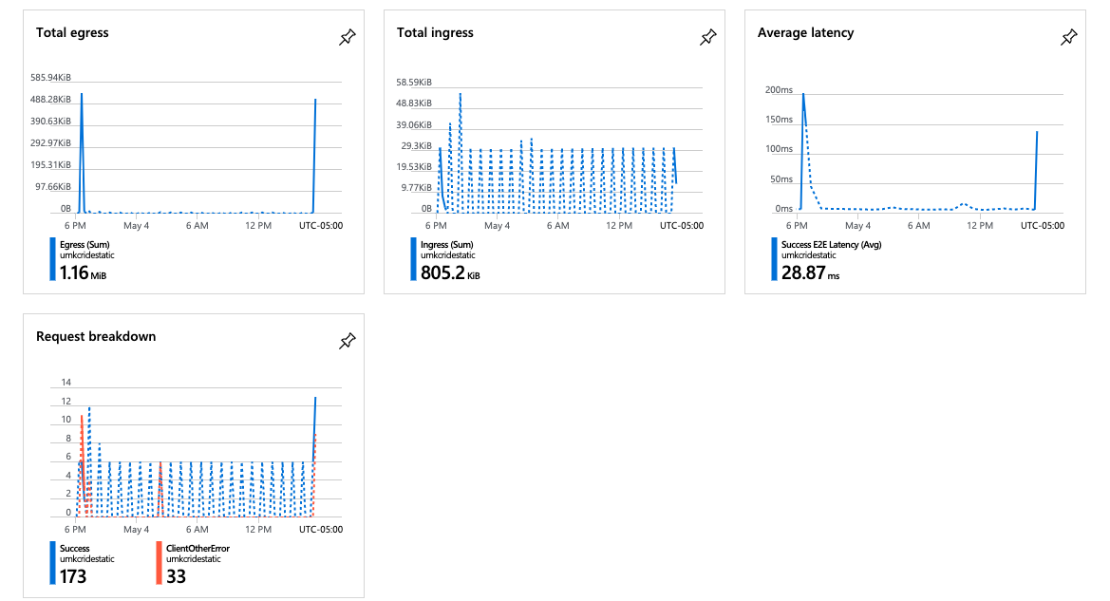

Slide 34
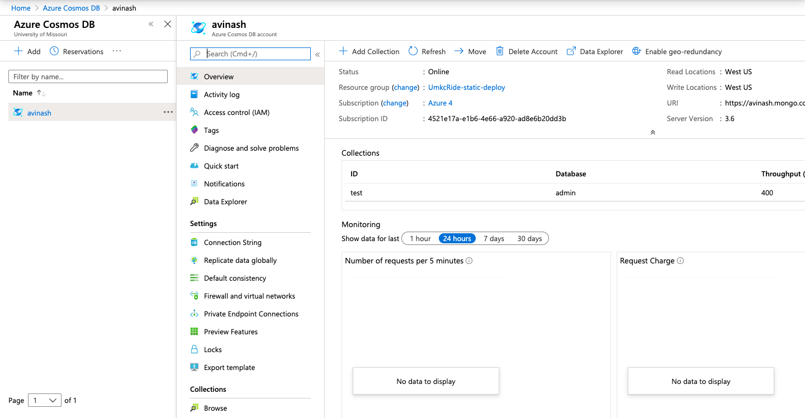
Azure Cosmos DB

Slide 35
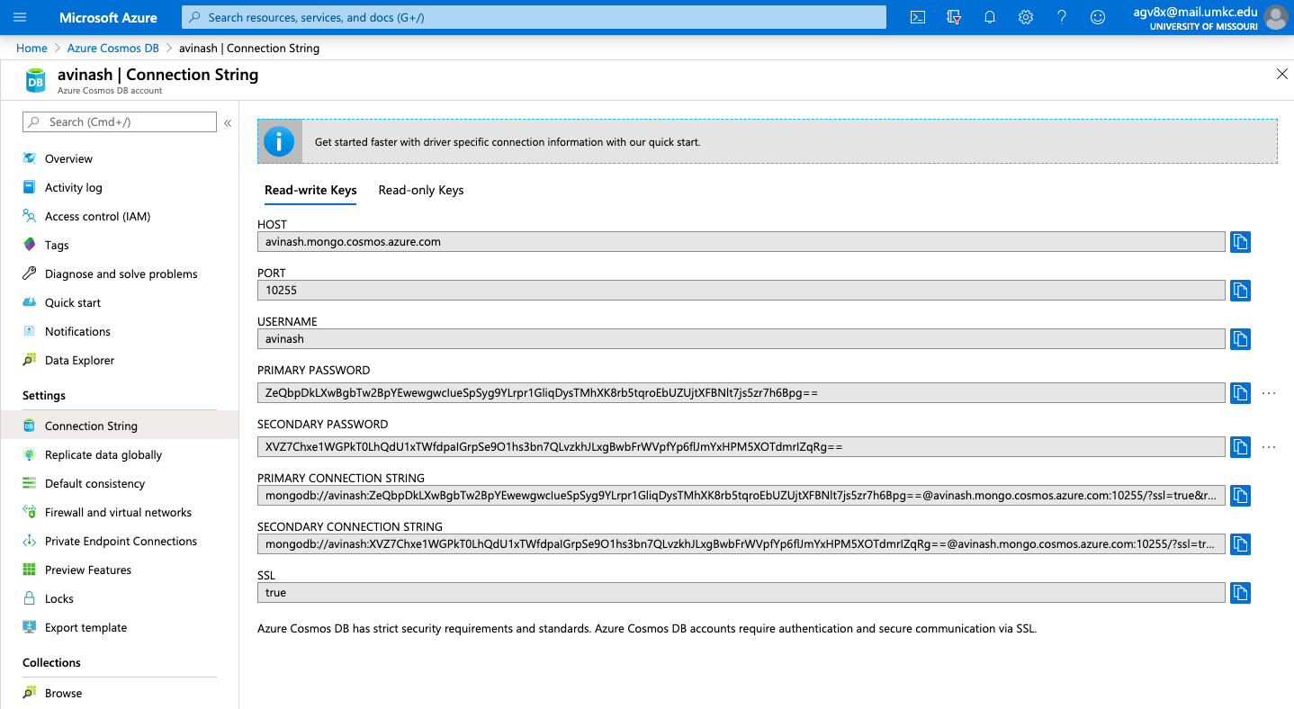

Slide 36
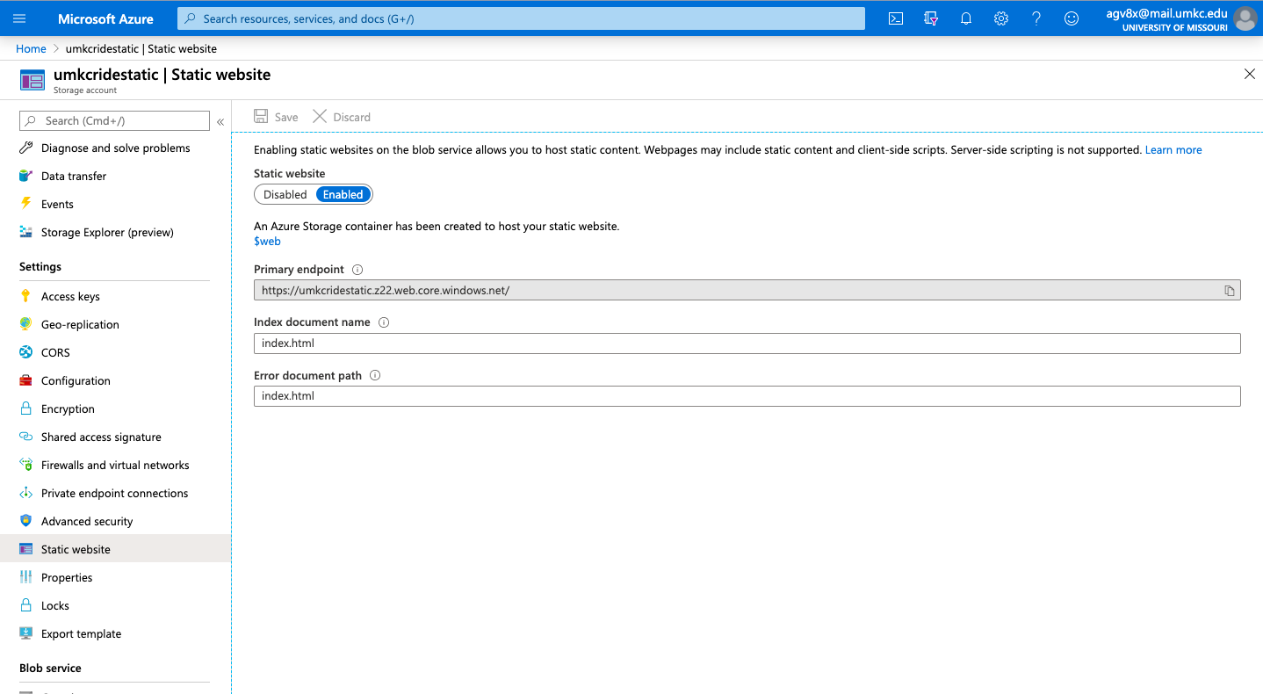

Slide 37
Challenges and Approaches
Faced issue while using GMaps REST API and overcame by restricting the API key
Migrating the MongoDB to Azure Cosmos Db is quite complex
Deploying the whole Angular project to Azure is hard compared to deploying a single Html page. But through stack overflow we have implemented it.
Cannot generate the apk file and ipa file for the Ionic Application due to several unstable dependencies.

Slide 38
Individual Learning/Contribution – can be clearly identified in our trello
Avinash Ganguri – creating angular components, dealing REST API’s, Software testing, Azure deployment.
Bhashitha Siddareddy – creating ionic components, node and express frameworks, Azure deployment.
Divya Reddy Bandari – creating ionic components, UI design, Mongo DB, service calls, Azure deployment.
Team Collaboration – we live in the same apartment so face to face interaction is more.
Teamviewer
Slack
Zoom meetings, once or twice a week

Slide 39
Conclusion
Built a Hybrid Application for UMKC to provide convenient transportation facilities to the students by offering services either by a person or by a shuttle through organization.
Also extended the UMKC Ride share to different organizations through a web Application for admin management.
References
Github link for IONIC Application : https://github.com/avinashganguri/UMKC-RIDE
Github link for Angular Application : https://github.com/avinashganguri/UMKC-Ride-Web
Trello Link : https://trello.com/b/GkbG2Yf3
Website Link : https://umkcridestatic.z22.web.core.windows.net/login [email id : superadmin@gmail.com password: 123456 (use superadmin as option to login)]

Slide 40
THANK YOU

